Slide 1
Small and Medium Enterprises Development Authority (SMEDA)
“Workshop on Entrepreneurship for Engineers”
Mukesh Kumar
(Provincial Chief, SMEDA Sindh)
@ The Institution of Engineers Pakistan
Sep 23, 2017

Slide 2
Entrepreneurship for Engineers
Why Engineers can be betters entrepreneurs:
Technical Knowledge
Analytical Skills
Patience & eagerness to Learn
Problem solving mindset
Trust building
Humble

Slide 3
Scheme of Presentation
Introduction
SMEDA Key Achievements
Areas of SMEDA Services
Entrepreneurship for Engineers

Slide 4
Introduction

Slide 5
Introduction
Established through Prime Minister’s Notification October, 1998
SMEDA is an “Autonomous Body” under the SMEDA Ordinance, 2002

Slide 6
Mandate & Mission
Initiate, Take, Continue, Implement & Perform Any & All Activities for Encouraging and Facilitating Growth & Development of SMEs
To assist in Employment Generation and
Value Addition to the National Income,
through
Development of the SME Sector,
by helping Increase the Number, Scale and Competitiveness of SMEs

Slide 7
Evolutionary Phases of SMEDA
Phase V
Jan 13 - onwards
Phase IV
Jul 06 – Dec 12
Phase III
Nov 04 - Jun 06
5 Years SME
Development Plan
&
PM Youth Initiative
Project Impl.
Sect. Strategy,
Policy & BDS
Phase II
Nov 02 - Oct 04
Sect. Strategy
BDS &
Facilitation
13 Sector Dev. Plans
Improving Policy & Regulatory Environ.
Developing Entre. Ecosystem
PM’s Youth Dev. Initiatives
PMYBL
HR & Skills Dev.
Intr’l Dev. Partners
ERKF
IPU
Industry Support through:
JICA, (Auto)
Giz, Bfz (Energy & Productivity)
Implem. Of 5 Yr. SME Dev. Plan
PCI – Value Addition through Cluster Dev.
PSDP Projects
BDS. Support
Public Sector Dev. Programme
SME Policy 2007
ICA
Baseline Survey
Sector Strategy Development for:
Leather
Sports Goods
ISP – Auto sector, Energy Efficiency
Southern Punjab Projects
Business Dev. Service
Phase I
Dec 98 - Oct 02
Research,
Cluster Dev.
Outreach & BDS
PISDAC
Dairy
Marble & Granite
Gems & Jewelry
Furniture
Surgical
Hunting & Sporting Arms
Ind. Info. Network
Info. Resource Centre
AHAN
Women Info. Network
CFCs
ISP –Textiles
BDS
Sector Strategy
Dev. & Facilitation
Research Studies (WB, ADB, ILO)
Cluster Dev. For :
Bangles
Auto Vendors
Ginning
Power Looms
Ceramic
Agri-business
Cutlery
Leather Garments
Outreach – RBCs
Shell Tameer
Business Dev. Services (BDS)
Textile Vision 2005
Fisheries
Transport
HEXPO 2000
Dairy
Leather Outlook
Engineering Vision
Mining Industries
Helpdesks
OTC Products
Website launched
Training Services
Publications
7
7

Slide 8
Operational Strategy
Building a Conducive Environment
Proposing and facilitating changes in Policy and Regulatory Environment
Reducing the Cost of Doing Business
Facilitating Government-SME Interface
Developing Sectors and Clusters
Sector Studies, Strategies and Implementation
Cluster Development
Common Facility Centers (CFCs)
Provision and Facilitation of Services
Investment Facilitation
Technology, Training, Finance, Business Information, Marketing, and legal support
Productivity and Competitiveness Improvement
Notes:
Building a Conducive Environment
Proposing and facilitating changes in Policy and Regulatory Environment
SME Policy
Budgetary & Trade Policies recommendations
Participating in Industrial Policy Exercise
Reducing the Cost of Doing Business
Formal Lending Cost: Development of Program Lending models for Power Loom, Fisheries, Cutlery, Auto parts Vendors, Schools etc.
Taxation policy & Procedure e.g. Income tax & Sales tax
Major policy shake up on import tariffs for Raw Materials
Utilities next target: Power Tariff, Telephone etc.
Facilitating Government-SME Interface
Public Private Dialogue; Policy Consultative Processes in Fiscal, Trade & Monetary
Developing Clusters and Sectors
Sector Studies, Strategies and Implementation
Marble & Granite, Dairy strategy, Poultry Sector Strategy, Leather, Garments, Horticulture, Fisheries, Textiles, Transport
Cluster Development
Ceramic Pottery, Fans, Surgical, Garments, Cutlery, Leather, Furniture, Gems & Jewelry, Ginning, Handloom etc.
Common Facility Centers

Slide 9
Categories of Support
SECTOR DEVELOPMENT
STRATEGIES
OVER THE COUNTER PRODUCTS
& SERVICES
LEGAL ADVICE & SUPPORT
SUPPORT
HRD SUPPORT TO SMEs
RESEARCH & POLICY SUPPORT
COMMON FACILITY CENTERS
INDUSTRY SUPPORT – PRODUCTION
EFFICIENCY IMPROVEMENT
ASSISTANCE IN ACCESS
TO FINANCE

Slide 10
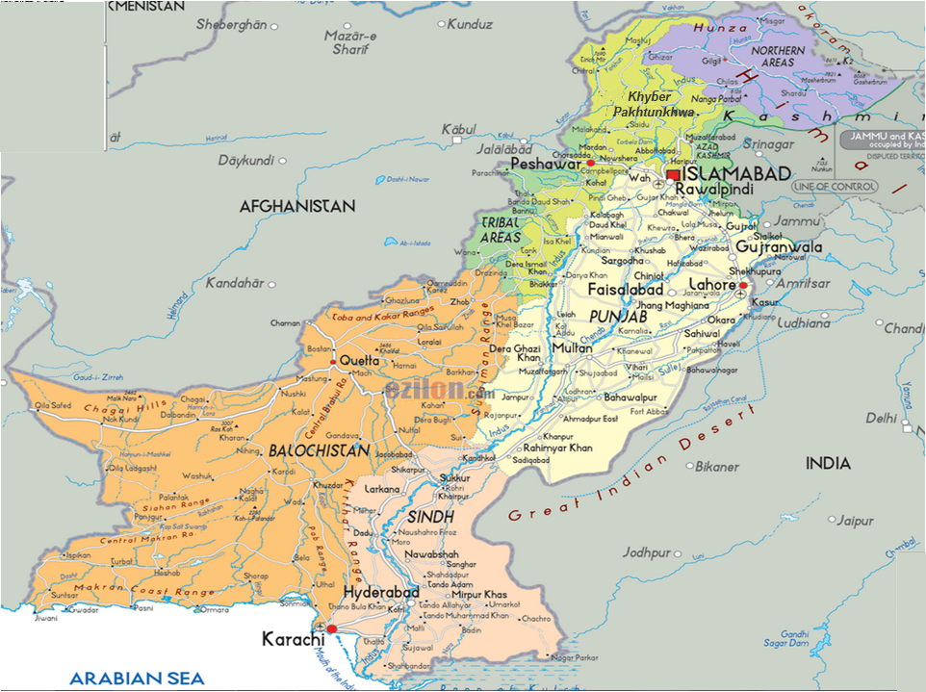
SME Density & SMEDA Outreach
14.21%
Mingora
2.18%
Issues
65.26%
Ghotki
17.83%
Provincial Offices (4)
Hub
RBCs (25)
Source: Census of Economic Establishments 2005

Slide 11
SMEDA’s Key Achievements
(1998-2015)

Slide 12
Key Achievements
Over 91,311 walk-in SMEs facilitated
356 Business Plans prepared
SMEDA Web Portal
Total number of Visitors: 9.95 Million
Avg. Visitors per day: 2,476
Development & Downloads of:
170 Pre-feasibility Studies – 2.26 Million Downloads
54 Regulatory Procedures – 353,331 Downloads
319 Commercial Contracts – 106,966 Downloads
Sector Briefs / Sectoral Information – 24,303 Downloads
SMEDA Accounting Package (SMAP) – 30,793
2,335 training programs organized with 100,290 participants
Investment facilitation of over Rs. 28 billion
Industry Support to over 495 firms

Slide 13
Key Achievements
Projects with International Development Partners:
Economic Revitalization of Khyber Pakhtunkhwa and FATA - Multi Donors Trust Fund (MDTF)
Early Recovery & Restoration of Flood Affected Communities - UNDP
Investment Promotion Unit (IPU) – UNIDO/Italian Govt.
28 Sector Strategies developed and updated
Demonstration Projects undertaken through PSDP Funding (27)

Slide 14
Key Achievements Prime Minister’s Youth Business Loan Scheme
Information Resources and tools developed:
85 Pre-feasibility Studies developed (Also translated into Urdu)
Financial Calculators - 4
Training Video Documentaries - 7
Over 14.31 million downloads of information Resources & Tools
Over 23,167 walk-in loan applicants facilitated at SMEDA Helpdesks
SMEDA’s Media Participation – 29 programs
Training to Partner Organizations – 6
Training Provided - 294 participants from 38 cities
Capacity building support to 21 organizations for prefeasibility development, helpdesk operations and website revamp
60 new Pre-feasibilities developed by Ministries / Organizations
17 Websites of MoIP and its Organizations revamped to cater for the requirements of PMYBL Beneficiaries

Slide 15
Development Partners
Multilateral Donors
International Agencies
Asian Development Bank
SME Sector Development Program
Rural Modernization Project
The World Bank
IC I & II
USAID
Pakistan Initiative for Strategic Development and Competitiveness (PISDAC)
UNDP
Pro-Gole
Early Recovery
UNIDO
Cluster Development Program
Investment Promotion Unit
ILO
Research Studies
European Union
Seminars/Conferences
WIPO
IPR publications & awareness
JICA
Senior volunteers
ITC, Geneva
Adaptation of Publications
Seminars
SES, GIZ, Bfz, Germany
Energy Efficiency & Renewable Energy
KOSGEB, Turkey
Investment & Trade Promotion
SEHDA, Mauritius
Trade Delegations
CBI, Netherlands
Export Coaching Programs , Productivity Enhancement Programs , CSR for Industry
ECO
Proposals & Conferences
D-8

Slide 16
SMEs Development Plan

Slide 17
SME Development
Vision
Growth of globally competitive SME sector,
through a conducive environment and
support services, serving as an engine of sustainable growth
for national economy
Goal
New Jobs
Value Addition in
GDP
New Enterprises &
Increasing Scale
Exports
Strategy
Policy Advocacy
Sector Development
Entrepreneurial
Ecosystem Dev.
Access to Finance
E-Enablement
Business Dev.
Services
Institutional
Support
Partnerships
Effective
Coordination
Reliable
Database
Monitoring &
Evaluation

Slide 18
Sectors
Food Processing
Plastic & Packaging
Construction
Electrical & Electronics
Engineering (Auto parts, Foundry, Surgical goods, fans, cutlery etc)
Chemicals
Food & Beverages
ICT

Slide 19
Thank You

